Slide 1
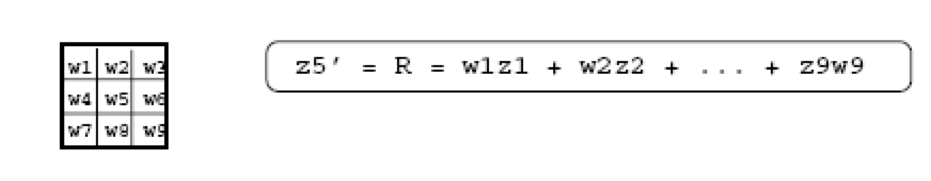
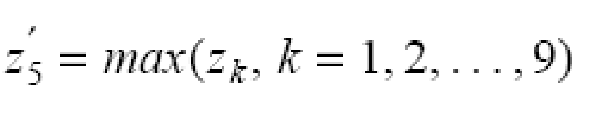
Linear vs Non-Linear Spatial Filtering
A filtering method is linear when the output is a weighted sum of the input pixels.
Methods that do not satisfy the above property are called non-linear.
*
COMSATS University Islamabad, Lahore Campus -- Advanced Topics in Digital Image Processing -- CSC650
1

Slide 2

Example
10
5
3
0
0
0
4
6
1
0
0.5
0
8
1
1
8
0
1
0.5
Local image neighborhood
mask
Modified image data
*
2
Notes:
2

Slide 3
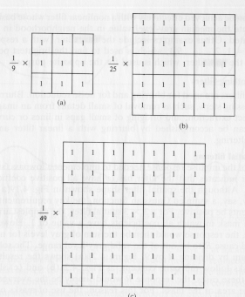
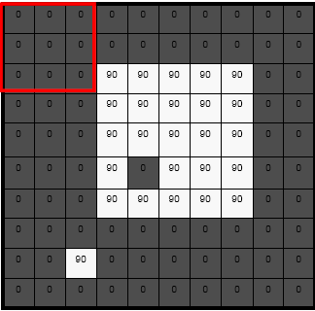
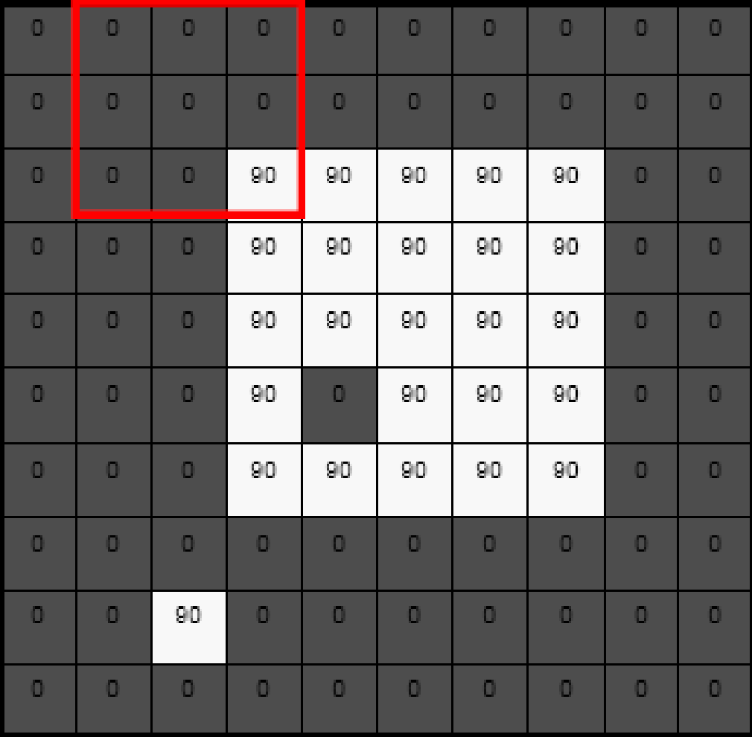
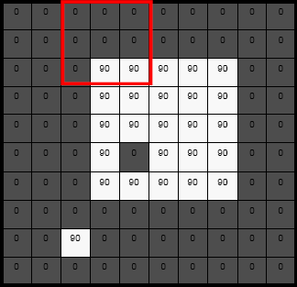
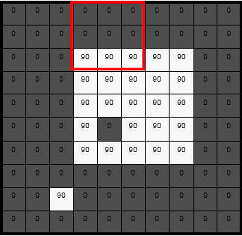
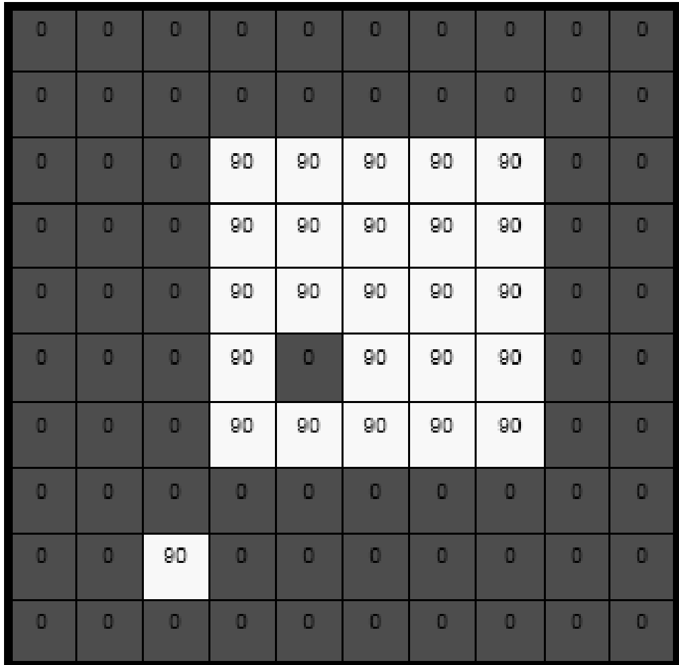
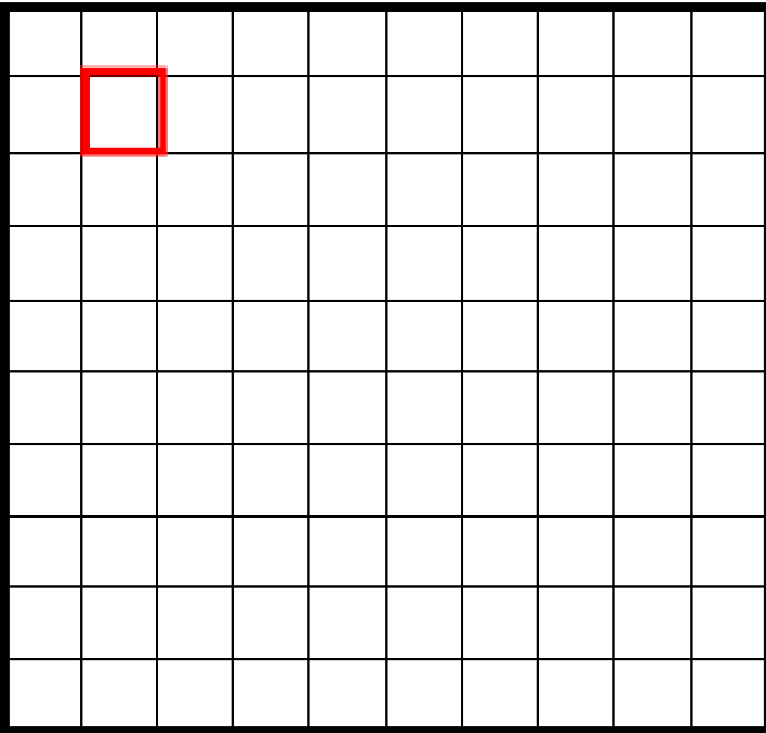
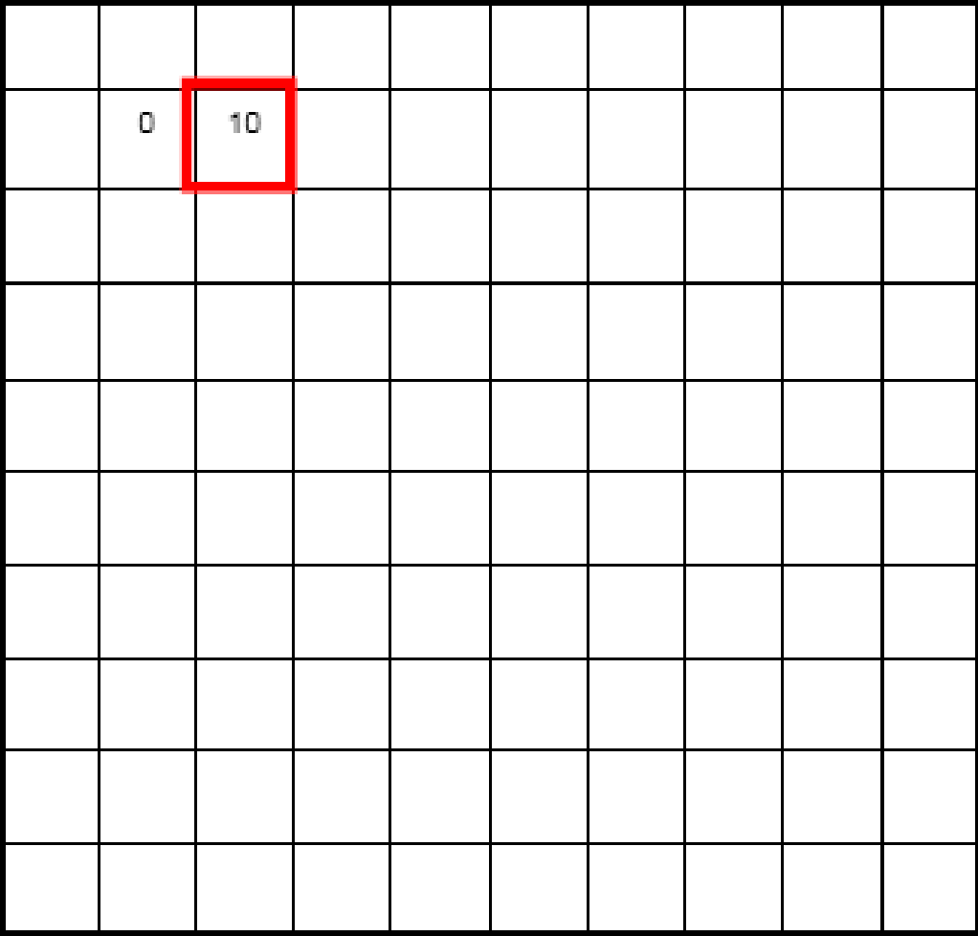
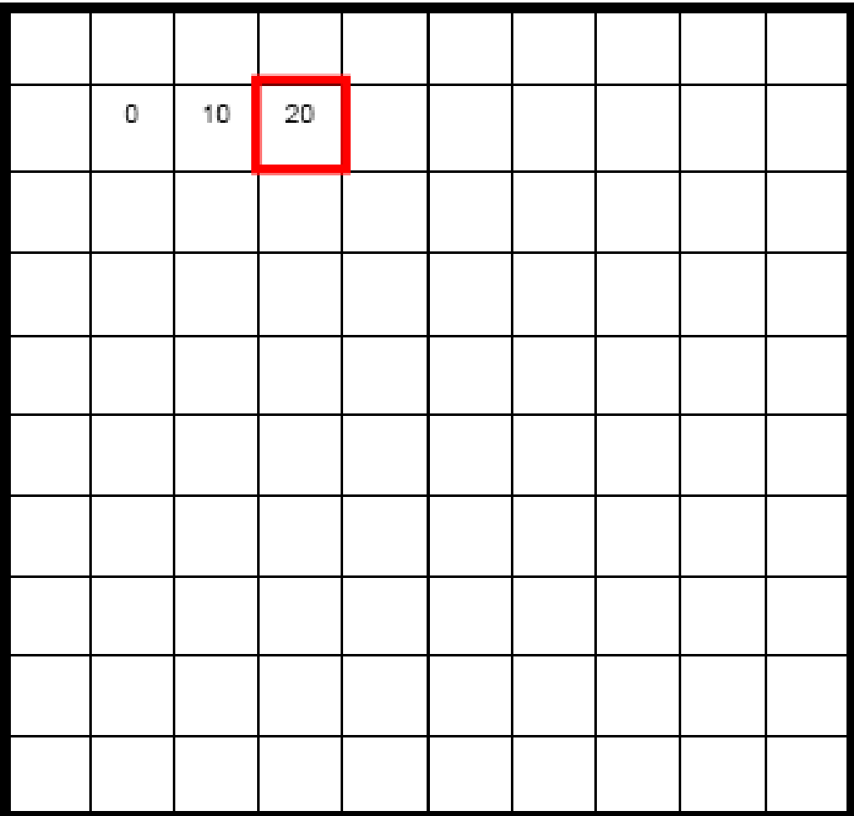
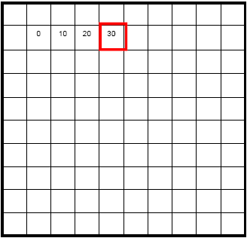
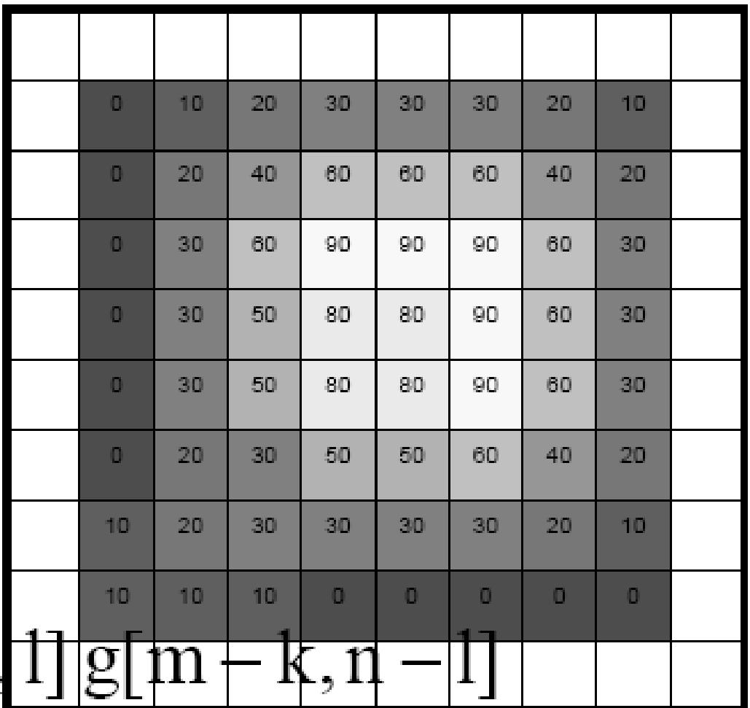
Example
*
3
Notes:
3

Slide 4
Linear Spatial Filtering
Two main linear spatial filtering methods:
Correlation
Convolution
*
4

Slide 5
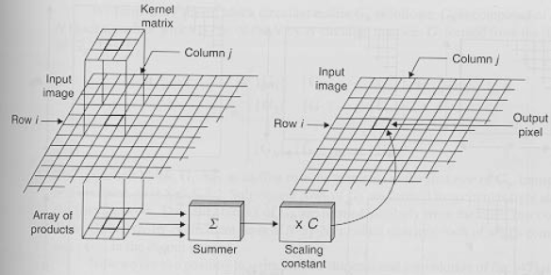
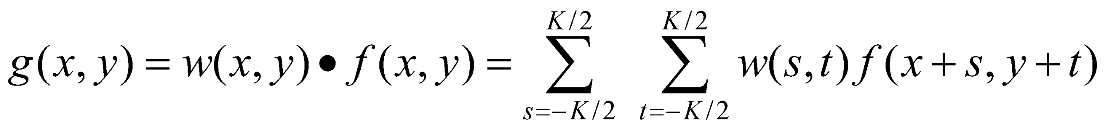
Correlation
w(i,j)
f(i,j)
*
5

Slide 6
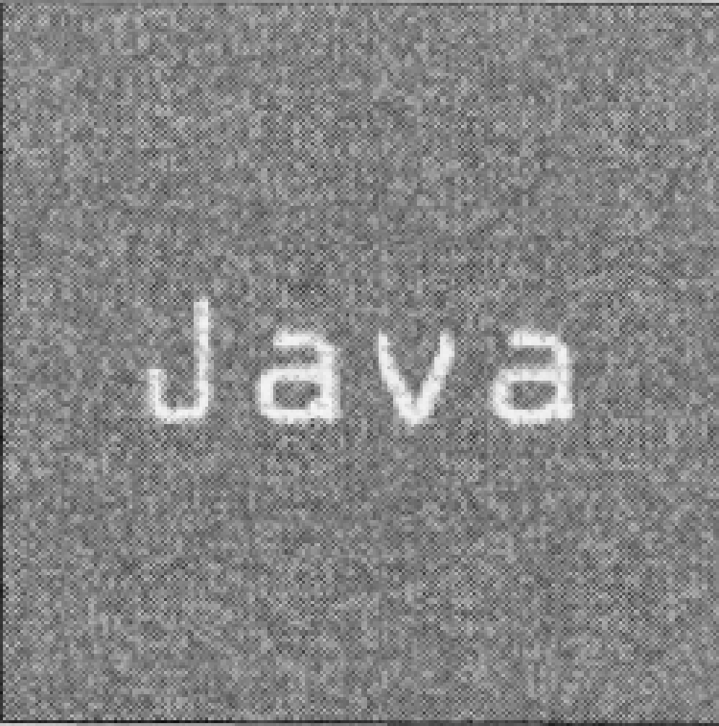
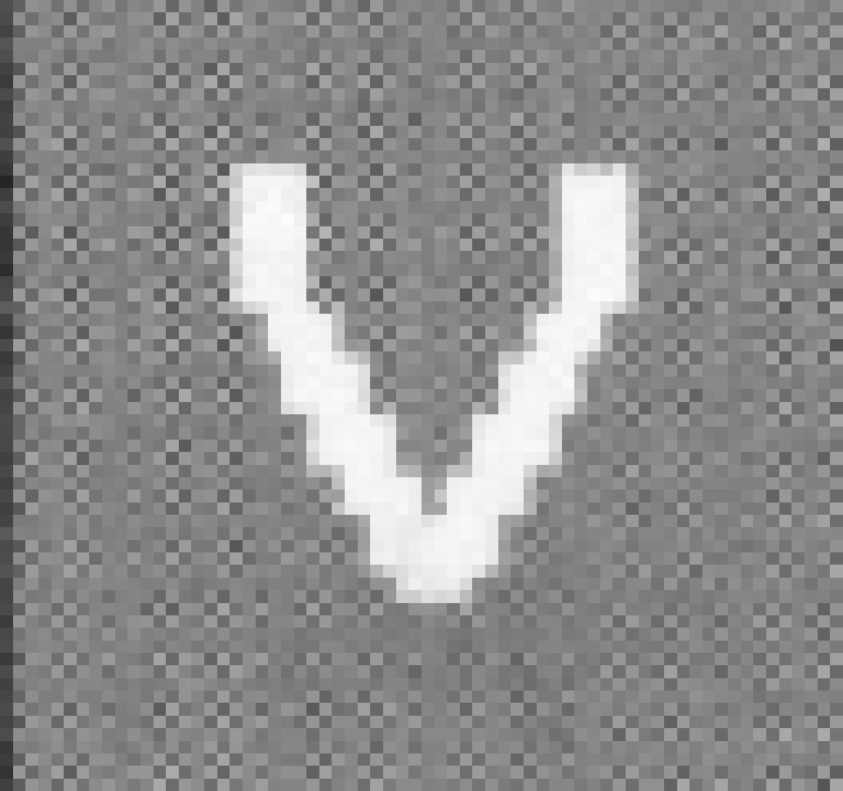
Correlation
Often used in applications where we need to measure the similarity between images or parts of images
(e.g., pattern matching).
*
6

Slide 7
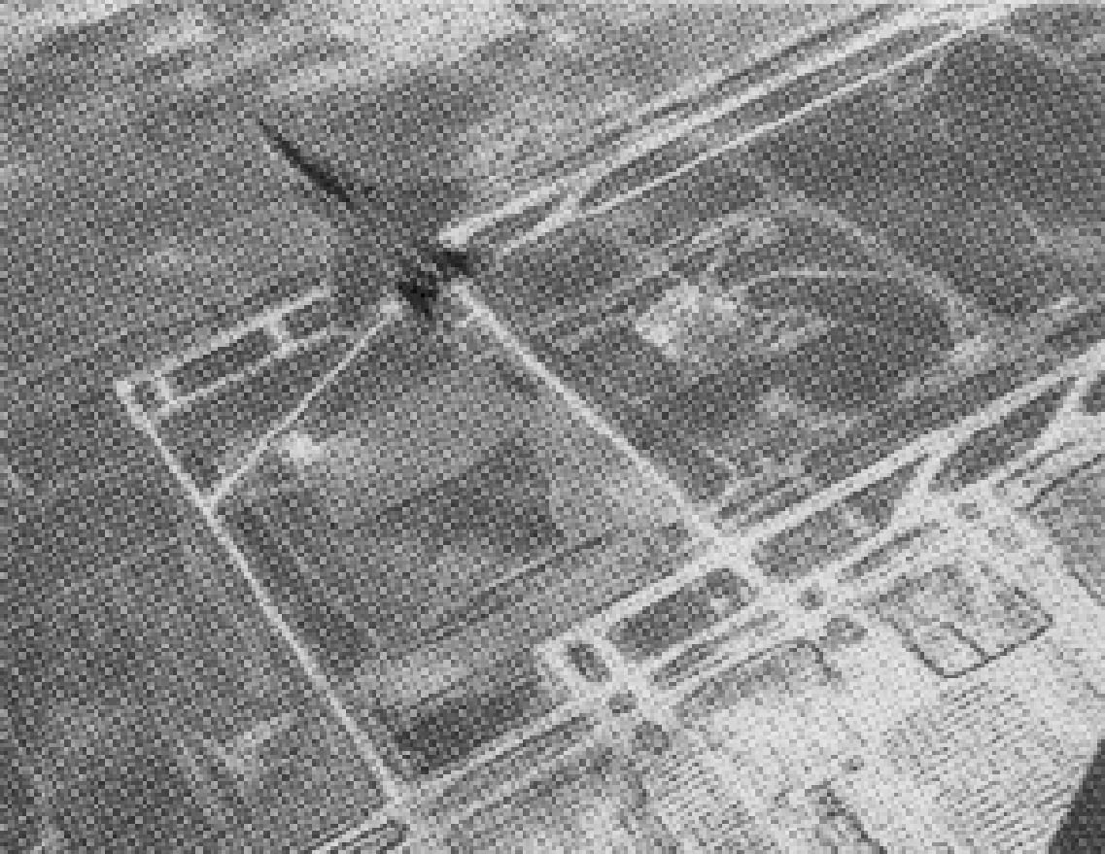
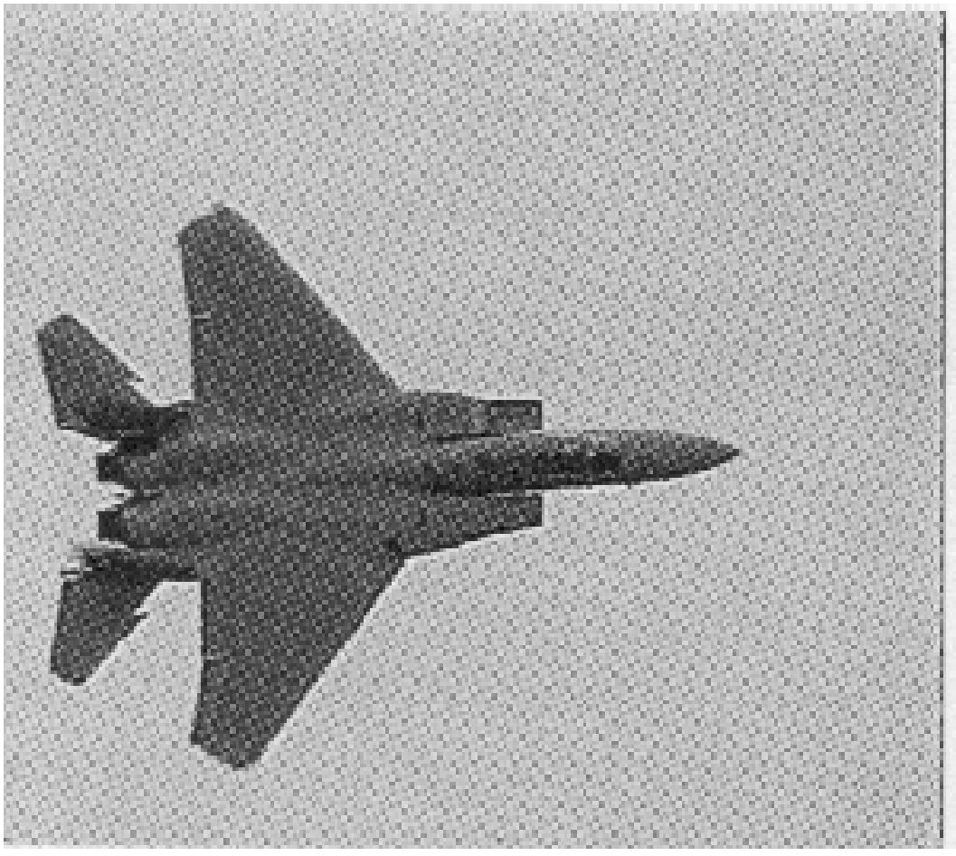
Correlation (cont’d)
Traditional correlation cannot handle changes due to:
size
orientation
shape (e.g., deformable objects).
?
*
7
Notes:
7

Slide 8
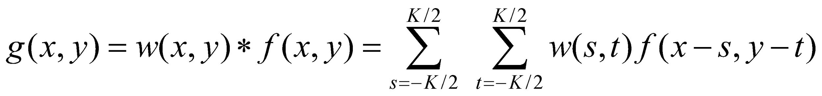
Convolution
Similar to correlation except that the mask is first flipped both horizontally and vertically.
Note: if w(x,y) is symmetric, that is w(x,y)=w(-x,-y), then convolution is equivalent to correlation !
*
8

Slide 9
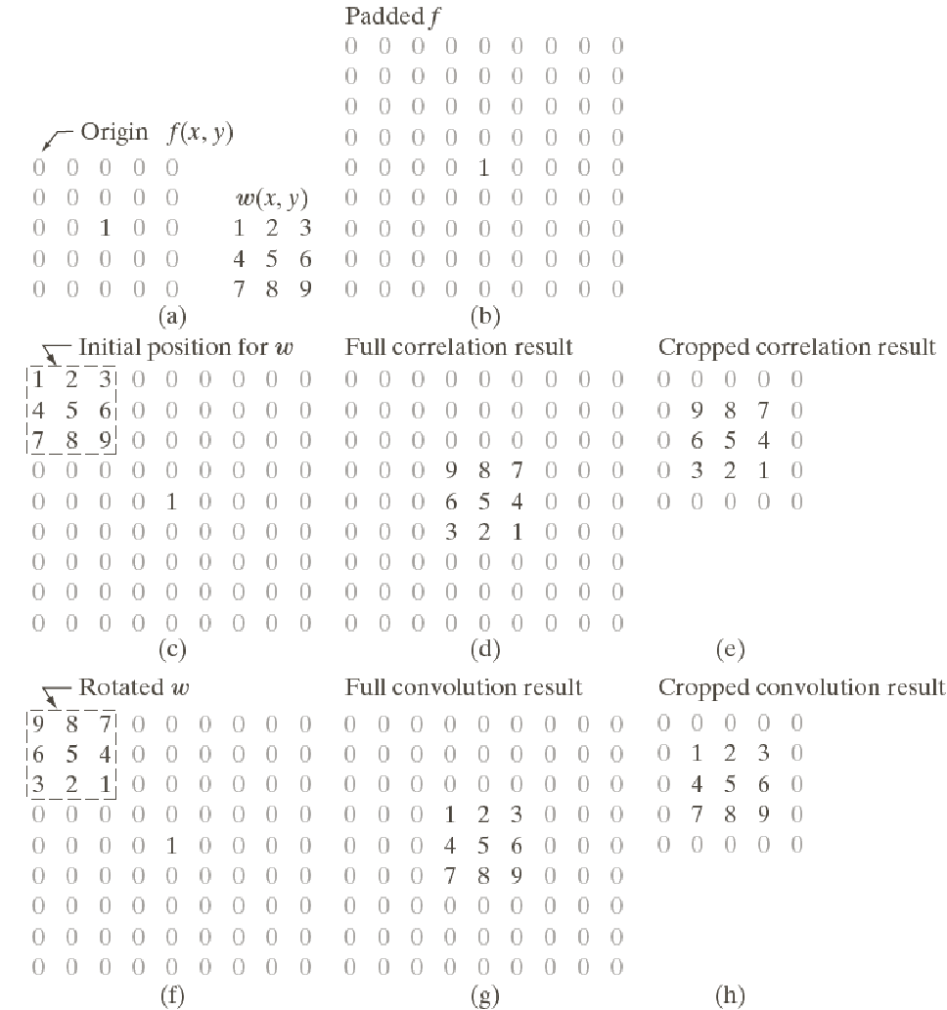
Convolution Vs Correlation
Correlation:
Convolution:
*
9

Slide 10
Filters
Smoothing (i.e., low-pass filters)
Reduce noise and small details.
The elements of the mask must be positive.
Sum of mask elements is 1
*
10

Slide 11
Averaging Filters
*
11

Slide 12
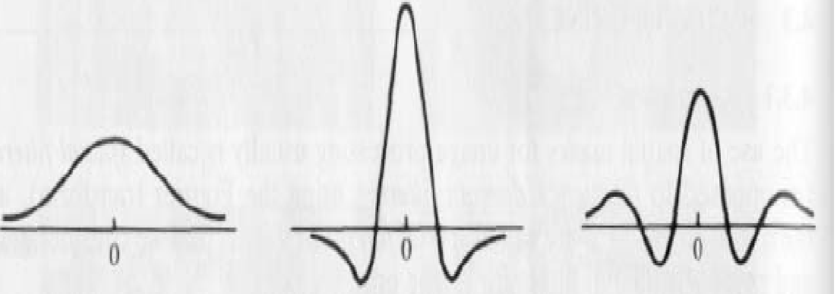
Filters
Sharpening (i.e., high-pass filters)
Highlight fine detail or enhance detail that has been blurred.
The elements of the mask contain both positive and negative weights.
Sum of the mask weights is 0
1st derivative
of Gaussian
2nd derivative
of Gaussian
*
CUI, Lahore Campus -- CSC 331: Digital Image Processing -- © Dr. Usama Ijaz Bajwa
12

Slide 13
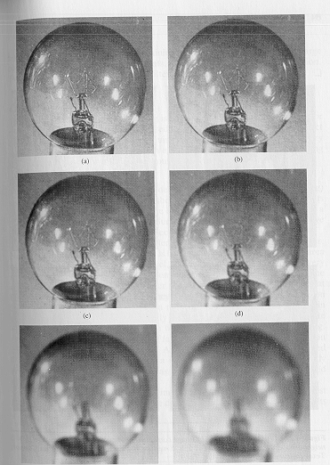
Averaging Filters
Mask size determines the degree of smoothing and loss of detail
original
3x3
5x5
7x7
15x15
25x25
*
CUI, Lahore Campus -- CSC 331: Digital Image Processing -- © Dr. Usama Ijaz Bajwa
13

Slide 14
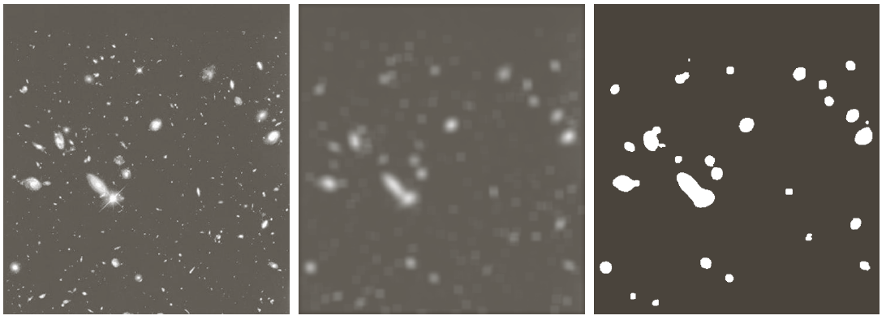
Averaging Filters
Example: extract, largest, brightest objects
15 x 15 averaging
image thresholding
*
CUI, Lahore Campus -- CSC 331: Digital Image Processing -- © Dr. Usama Ijaz Bajwa
14

Slide 15
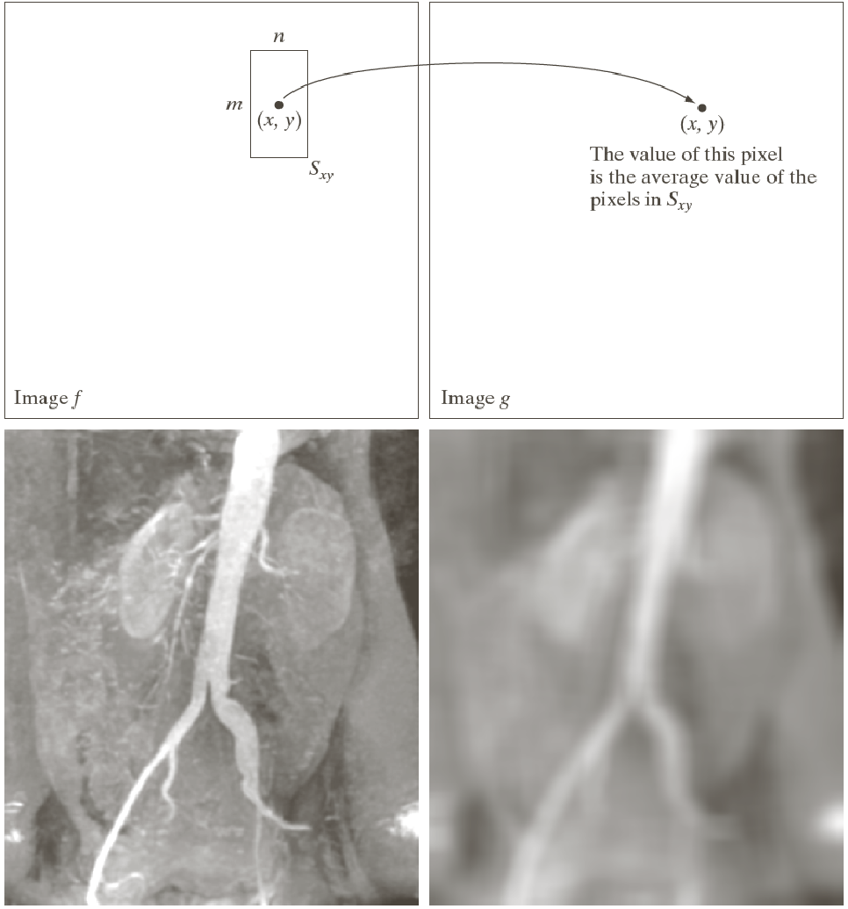
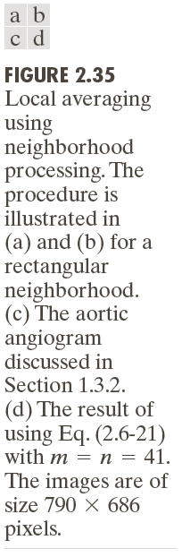
Spatial Operations - Neighborhood Operations
*
15

